Slide 1
DOES GOD EXIST?
What do you mean by “God”?

Slide 2
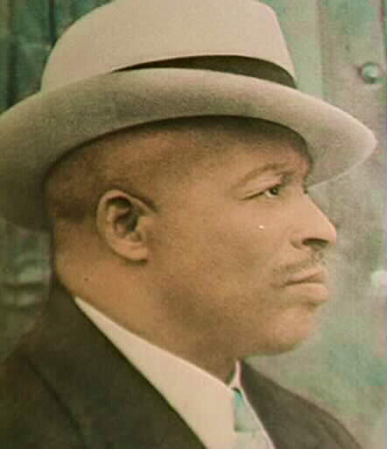
Father Divine?

Slide 3
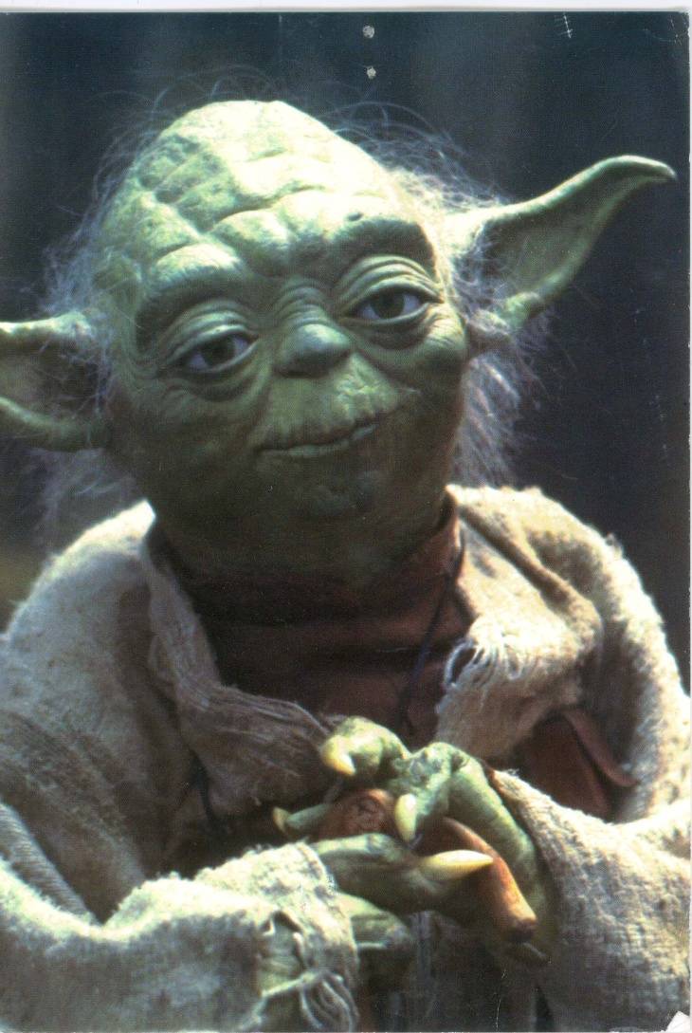
The Good Side of the Force?

Slide 4
What attributes would something have to have in order to be God ?
Omniscience
Omnipotence
Omni-benevolence
Creator of the Universe

Slide 5
We shall mean by “God”:
A being who is omniscient, omnipotent, and omni-benevolent … or at least very knowledgeable, very powerful, and very good… and created the Universe.
Our question: “What reasons are there to believe or disbelieve in the existence of a being who has some or most of these attributes?”

Slide 6
“No intelligent person could believe in God”
Isaac Newton 
Albert Einstein (Spinozian God)
James Clerk Maxwell 
Niels Bohr 
Werner Heisenberg 
Galileo Galilei 
Richard Feynman X
Paul Dirac X
Erwin Schroedinger 
Ernest Rutherford 
Kurt Goedel (Infinite Mind)

Slide 7
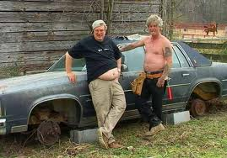
TYPICAL THEISTS

Slide 8
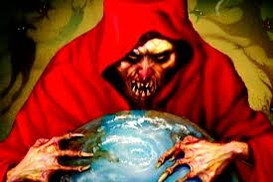
TYPICAL ATHEIST

Slide 9
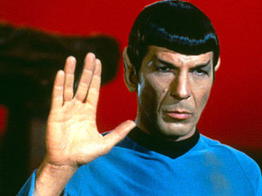
LOGIC?

Slide 10
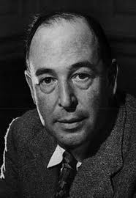
C. S. LEWIS

